Slide 1
Chapter 7
Navigation Menus

Slide 2
Objectives
Applied
Create links and lists in all their variations with HTML and with CSS.
Knowledge
Name and describe the three types of HTML lists.
Describe the use of <a> elements for linking to another web page, opening another web page in a new browser window, linking to placeholders on the same page, linking to media files, starting an email message, calling a phone number, or starting a Skype session.
Describe the use of unordered lists and <a> elements for the creation of navigation lists and navigation menus, including 2- and 3-tier menus.
Describe the use of these pseudo-classes for formatting links: :link, :visited, :hover, and :focus.
Describe the use of these CSS properties for formatting links: text-decoration and border.

Slide 3
HTML for an unordered list with paragraphs and links
<h1>San Joaquin Valley Town Hall Programs</h1>
<ul>
<li>
<p>Join us for a complimentary coffee hour at the
<a href="saroyan.html">William Saroyan Theatre</a>, 9:15 to 10:15
a.m. on the day of each lecture. The speakers usually attend this very special event.</p>
</li>
<li>
<p>Extend the excitement of Town Hall by purchasing tickets to the post-lecture luncheons. This unique opportunity allows you to ask
more questions of the speakers--plus spend extra time meeting new Town Hall friends.</p>
<p>A limited number of tickets are available. Call (559) 555-1212 for reservations by the Friday preceding the event.</p>
</li>
</ul>

Slide 4
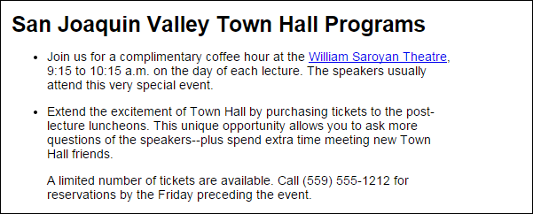
The unordered list in a web browser

Slide 5
An ordered list that is continued
<h1>How to use the WinZip Self Extractor</h1>
<h2>Before you start the WinZip Self Extractor</h2>
<ol>
<li>Create a text file that contains the message you want to be displayed when the executable starts.</li>
<li>Create a batch file that copies the exercises, and store it in the main folder for the files to be zipped.</li>
<li>Create the zip file.</li>
</ol>
<h2>How to create an executable file</h2>
<ol start="4">
<li>Run the WinZip Self Extractor program and click through the first three dialog boxes.</li>
<li>Enter the name of the zip file in the fourth dialog box.</li>
<li>Click the Next button to test the executable.</li>
</ol>

Slide 6
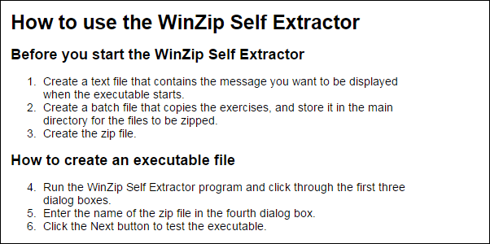
The ordered list in a web browser

Slide 7
Ordered lists nested within an unordered list
<h1>How to use the WinZip Self Extractor program</h1>
<ul>
<li>Before you start the WinZip Self Extractor
<ol>
<li>...</li>
<li>...</li>
<li>...li>
</ol>
</li>
<li>How to create an executable file
<ol start="4">
<li>...li>
<li>...</li>
<li>...li>
</ol>
</li>
</ul>

Slide 8
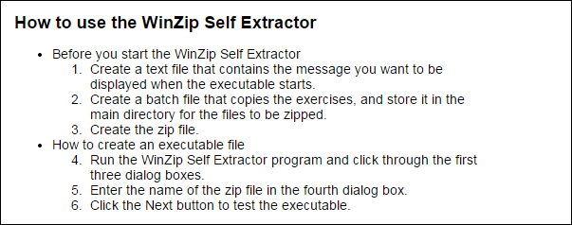
The nested lists in a web browser

Slide 9
HTML for a description list
<h2>Components of the Internet architecture</h2>
<dl>
<dt>client</dt>
<dd>A computer that accesses the web pages of a web application using a web browser.</dd>
<dt>web server</dt>
<dd>A computer that holds the files for each web application.</dd>
<dt>local area network (LAN)</dt>
<dd>A small network of computers that are near each other and can communicate with each other over short distances.</dd>
<dt>wide area network (WAN)</dt>
<dd>A network that consists of multiple LANs that have been connected together over long distances using routers.</dd>
<dt>Internet exchange point</dt>
<dd>Large routers that connect WANs together.</dd>
</dl>

Slide 10
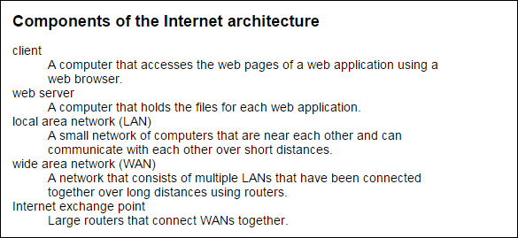
The description list in a web browser

Slide 11
Properties for formatting unordered lists
list-style-type
list-style-image
Values for the list-style-type property of an unordered list
disc
circle
square
none

Slide 12
HTML for two unordered lists
<h2>Popular web browsers include</h2>
<ul class="circle">
<li>Internet Explorer</li>
<li>Firefox</li>
<li>Chrome</li>
</ul>
<h2>Prime skills for web developers are</h2>
<ul class="star">
<li>HTML5 and CSS3</li>
<li>JavaScript</li>
<li>PHP</li>
</ul>
CSS that changes the bullets
ul.circle { list-style-type: circle; }
ul.star { list-style-image: url("../images/star.png"); }

Slide 13
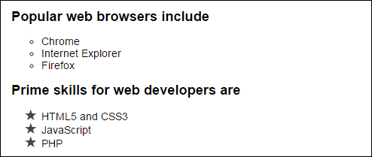
The bullet changes in a web browser

Slide 14
Common values for the list-style-type property of an ordered list
decimal
decimal-leading-zero
lower-alpha
upper-alpha
lower-roman
upper-roman

Slide 15
HTML for an ordered list
<h2>How to create an executable file</h2>
<ol class="lower_alpha">
<li>Run the WinZip Self Extractor program and click through the first three dialog boxes.</li>
<li>Enter the name of the zip file in the fourth dialog box.</li>
<li>Click the Next button to test the executable.</li>
</ol>
CSS that formats the list
ol.lower_alpha { list-style-type: lower-alpha; }

Slide 16
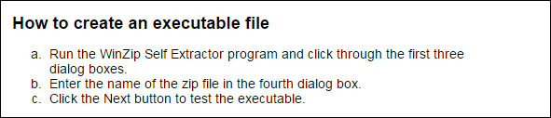
The ordered list changes in a web browser

Slide 17
HTML for an unordered list
<h2>Popular web browsers</h2>
<ul>
<li>Chrome</li>
<li>Internet Explorer</li>
<li>Firefox</li>
<li>Safari</li>
<li>Opera</li>
</ul>
CSS that aligns the list items
h2, ul, li {
margin: 0;
padding: 0;
}
ul { padding-left: 1em;
}
li {
padding-left: .25em;
padding-bottom: .25em;
}

Slide 18
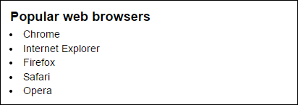
The aligned list items in a web browser

Slide 19
Four attributes of the <a> element
href
title
tabindex
accesskey

Slide 20
A text link, an image link, and a text link with a title attribute
<p>
<a href="/orders/cart.html" accesskey="c" tabindex="0">Shopping cart</a>
<a href="/orders/cart.html"> <img src="images/cart_animated.gif"
alt="Shopping cart"></a>
</p>
<p><a href="/books/php_toc.html"
title="Review the complete table of contents">TOC</a></p>

Slide 21
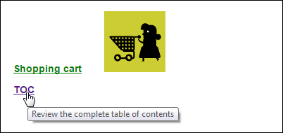
The text and image links in a web browser

Slide 22
Accessibility guidelines for links
If the text for a link has to be short, code the title attribute to clarify where the link is going.
You should also code the title attribute if a link includes an image with no text.

Slide 23
Common CSS pseudo-classes for formatting links
:link
:visited
:hover
:focus
:active

Slide 24
The properties for removing underlines and borders
text-decoration
border-style

Slide 25
The HTML for three links
<ul>
<li><a href="toobin.html">Jeffrey Toobin</a></li>
<li><a href="sorkin.html">Andrew Ross Sorkin</a></li>
<li><a href="chua.html">Amy Chua</a></li>
</ul>
The CSS for pseudo-class selectors that apply to the links
a:link {
color: green;
}
a:hover, a:focus {
text-decoration: none;
font-size: 125%;
}

Slide 26

The links in a browser with the focus on the third link

Slide 27
Accessibility guideline for :hover and :focus
Apply the same formatting for the :hover and :focus selectors.
That way, the formatting is the same whether you hover the mouse over a link or use the keyboard to tab to the link.

Slide 28
HTML for a link that loads the document in a new window or tab
<p>Just go to
<a href="http://www.html5test.com/" target="_blank">
the HTML5 testing site</a>. It rates your browser as it loads the page and also has data on how well other browsers conform to HTML5.
</p>

Slide 29
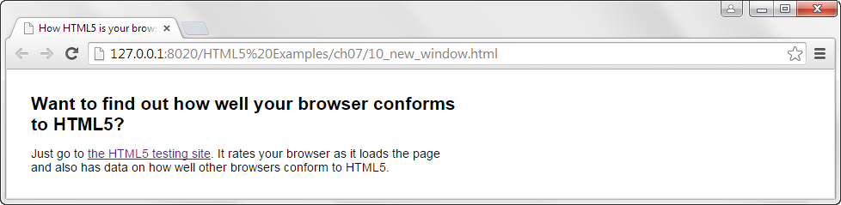
The HTML in one browser tab

Slide 30
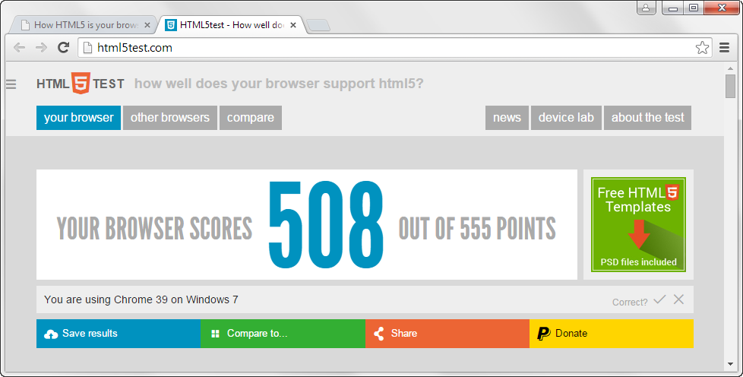
The html5test.com home page in another tab

Slide 31
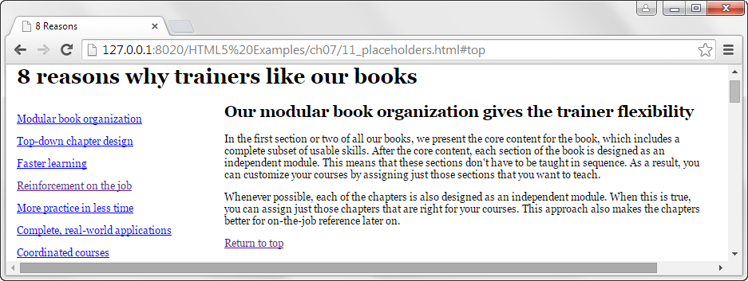
A web page that links to topics on the same page

Slide 32
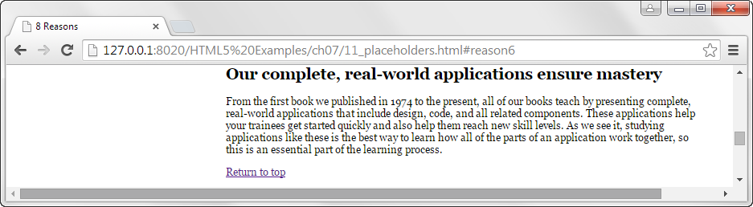
The page when the sixth link is clicked

Slide 33
Linking to placeholders on a page
The placeholder the top of the page
<h1><a id="top">8 reasons why trainers like our books</a></h1>
The placeholder for reason 6
<h2><a id="reason6">Our complete, real-world applications ensure mastery</a></h2>
Two links that jump to placeholders on the same page
<p><a href="#reason6">Complete, real-world applications</a></p>
<p><a href="#top">Return to top</a></p>
A link that jumps to a placeholder on this page from another page
<a href="8reasons.html#reason6">Complete, real-world applications</a>

Slide 34
Popular media formats
PDF
WAV
MP3
MPG/MPEG

Slide 35
An HTML link that displays a PDF file in a new window
<a href="documents/instructors_summary.pdf"
type="application/pdf"
target="_blank">Read the Instructor's Summary<a>

Slide 36
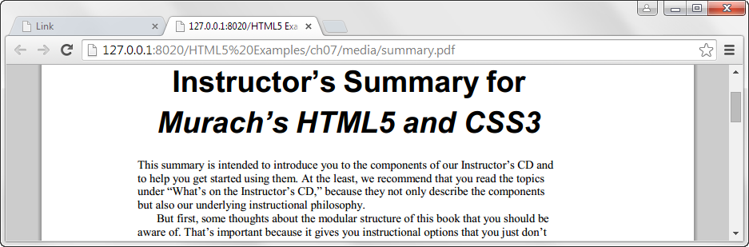
The PDF file in a browser

Slide 37
An HTML link that plays an MP3 file
<a href="music/twist_away.mp3" type="audio/mpeg"> MP3 file</a>

Slide 38
An HTML link that plays a PowerPoint slide show
<a href="media/chapter_01.pps"
target="_blank">Review the slides for chapter 1</a>

Slide 39

A web page with links for email, phone, and Skype

Slide 40
Email, phone, and Skype links
A link that starts an email message
<a href="mailto:support@murach.com">Send us an email</a>
An email link with a CC address and a subject
<a href="mailto:support@murach.com?cc=ben@murach.com &subject=Web mail">Send us an email</a>
A link that calls a phone number
<a href="tel:555-555-5555">Call us</a>
A link that starts a Skype session
<a href="skype:murachsupport">Skype chat with us</a>

Slide 41
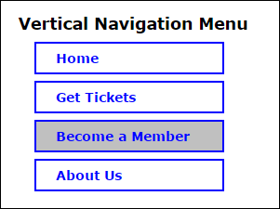
A vertical navigation menu

Slide 42
The HTML for the vertical navigation menu
<nav id="nav_list">
<ul>
<li><a href="index.html">Home</a></li>
<li><a href="tickets.html">Get Tickets</a></li>
<li><a href="members.html" class="current">Become a Member</a></li>
<li><a href="about_us.html">About Us</a></li>
</ul>
</nav>

Slide 43
The CSS for the vertical navigation menu
* { margin: 0;
padding: 0; }
#nav_menu_1 ul {
list-style-type: none;
margin-left: 1.25em;
margin-bottom: 1.5em; }
#nav_menu_1 ul li {
width: 200px;
margin-bottom: .5em;
border: 2px solid blue; }
#nav_menu_1 ul li a {
display: block;
padding: .5em 0 .5em 1.5em;
text-decoration: none;
font-weight: bold;
color: blue; }
#nav_menu_1 ul li a.current {
background-color: silver; }

Slide 44
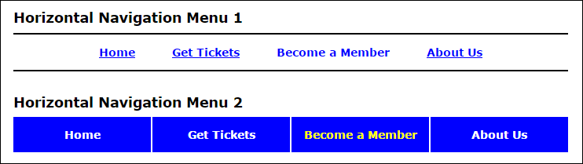
Two horizontal navigation menus

Slide 45
The HTML for the horizontal navigation menus
<nav id="nav_menu">
<ul>
<li><a href="index.html">Home</a></li>
<li><a href="tickets.html">Get Tickets</a></li>
<li><a href="members.html" class="current">Become a Member</a></li>
<li><a href="about_us.html" class="lastitem">About Us</a></li>
</ul>
</nav>

Slide 46
The CSS for the first horizontal menu
#nav_menu ul {
list-style-type: none;
padding: 1em 0; /* padding above and below li elements */
text-align: center;
border-top: 2px solid black;
border-bottom: 2px solid black; }
#nav_menu ul li {
display: inline;
padding: 0 1.5em; }
#nav_menu ul li a {
font-weight: bold;
color: blue; }
#nav_menu ul li a.current { text-decoration: none; }

Slide 47
The CSS for the second horizontal menu
#nav_menu ul { list-style-type: none; }
#nav_menu ul li { float: left; }
#nav_menu ul li a {
text-align: center;
display: block;
width: 175px;
padding: 1em 0; /* padding above and below a elements */
text-decoration: none;
background-color: blue;
color: white;
font-weight: bold;
border-right: 2px solid white; }
#nav_menu ul li a.lastitem { border-right: none; }
#nav_menu ul li a.current { color: yellow; }

Slide 48
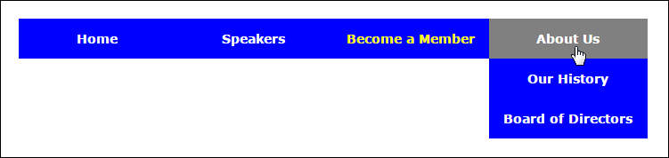
A 2-tier navigation menu

Slide 49
The HTML for the 2-tier menu
<nav id="nav_menu">
<ul>
<li><a href="index.html">Home</a></li>
<li><a href="#">Speakers</a>
<ul>
<li><a href="#">Jeffrey Toobin</a></li>
<li><a href="#">Andrew Ross Sorkin</a></li>
...
</ul>
</li>
<li><a href="members.html" class="current">Become a Member</a></li>
<li class="lastitem"><a href="aboutus.html">About Us</a>
<ul>
<li><a href="#">Our History</a></li>
<li><a href="#">Board of Directors</a></li>
</ul>
</li>
</ul>
</nav>

Slide 50
The CSS for the 2-tier menu
#nav_menu ul {
list-style: none;
position: relative;
}
#nav_menu ul li { float: left;
}
#nav_menu ul ul {
display: none;
position: absolute;
top: 100%;
}
#nav_menu ul ul li { float: none;
}
#nav_menu ul li:hover > ul {
display: block;
}
#nav_menu > ul::after {
content: "";
display: block;
clear: both;
}

Slide 51
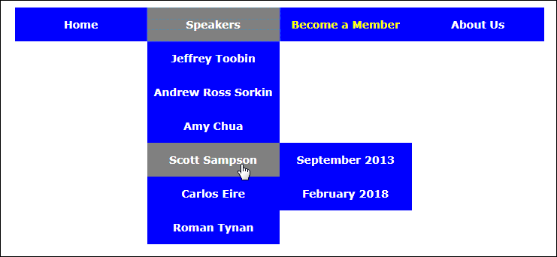
A 3-tier navigation menu

Slide 52
The HTML for the 3-tier menu
<nav id="nav_menu">
<ul>
<li><a href="index.html">Home</a></li>
<li><a href="speakers.html">Speakers</a>
<ul>
<li><a href="#">...</a></li>
<li><a href="#">...</a></li>
<li><a href="#">...Chua</a></li>
<li><a href="sampson.html">...</a>
<ul>
<li><a href="#">...</a></li>
<li><a href="#">...</a></li>
</ul>
</li>
<li><a href="#">...</a></li>
<li><a href="#">...</a></li>
</ul>
</li>
<li><a href="members.html">Become...</a></li>

Slide 53
The HTML for the 3-tier menu (continued)
<li class="lastitem"><a href="aboutus.html"> About Us</a>
<ul>
<li><a href="#">Our History</a></li>
<li><a href="#">Board...</a></li>
<li><a href="#">Past Speakers</a>
<ul>
<li><a href="#">2017</a></li>
<li><a href="#">2016</a></li>
<li><a href="#">2015</a></li>
</ul>
</li>
<li><a href="#"> Contact Information</a></li>
</ul>
</li>
</ul>
</nav>

Slide 54
The CSS for the operation of the 3-tier menu
#nav_menu ul {
list-style-type: none;
position: relative; }
#nav_menu ul li { float: left; }
#nav_menu ul ul {
display: none;
position: absolute;
top: 100%; }
#nav_menu ul ul li {
float: none;
position: relative; }
#nav_menu ul ul li ul {
position: absolute;
left: 100%;
top: 0; }
#nav_menu ul li.lastitem ul li ul {
position: absolute;
left: -100%;
top: 0; }
#nav_menu ul li:hover > ul { display: block; }
#nav_menu > ul::after {
content: "";
clear: both;
display: block; }

Slide 55
The CSS for formatting the 3-tier menu
#nav_menu ul {
margin: 0;
padding: 0; }
#nav_menu ul li a {
text-align: center;
display: block;
width: 176px;
padding: 1em 0;
text-decoration: none;
background-color: blue;
color: white;
font-weight: bold; }
#nav_menu ul li.lastitem a {
width: 178px; }
#nav_menu ul li a.current {
color: yellow; }
#nav_menu ul li a:hover, #nav_menu ul li a:focus {
background-color: gray; }

Slide 56
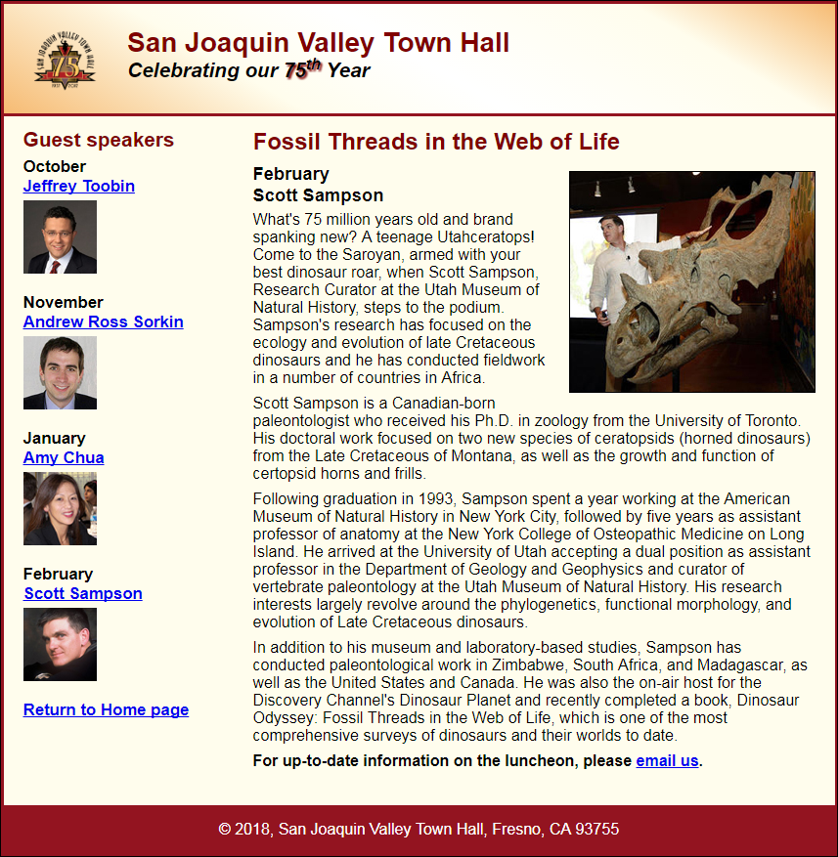
Short 7-1 Start an email

Slide 57
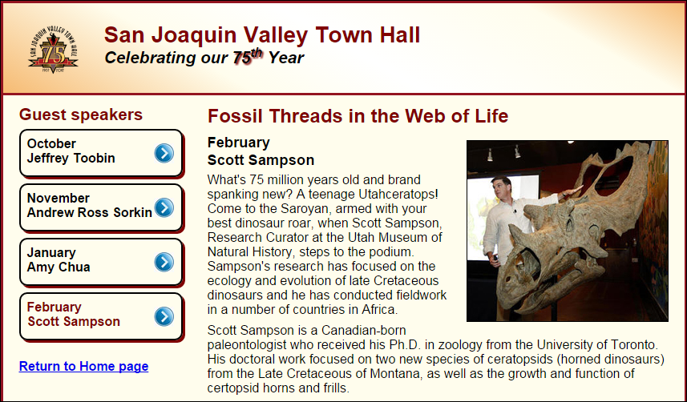
Short 7-2 Create a vertical navigation menu

Slide 58
Objectives
Applied
Create links and lists in all their variations with HTML and with CSS.
Knowledge
Name and describe the three types of HTML lists.
Describe the use of <a> elements for linking to another web page, opening another web page in a new browser window, linking to placeholders on the same page, linking to media files, starting an email message, calling a phone number, or starting a Skype session.
Describe the use of unordered lists and <a> elements for the creation of navigation lists and navigation menus, including 2- and 3-tier menus.
Describe the use of these pseudo-classes for formatting links: :link, :visited, :hover, and :focus.
Describe the use of these CSS properties for formatting links: text-decoration and border.

